Slide 1
INFM 603 Group Project
December 17, 2020

Slide 2
Group Members
Corie Brown
Jake Cupani
Mary Dalrymple
Keegan Maguigan
Nelson Reyes

Slide 3
Background
The group played the role of a hypothetical web development and consulting firm contracted by NASA to create a website related to its STEM Engagement Program.
The website would be used to further the goals of the program by increasing K-12 involvement in NASA projects, strengthening online education, and boosting NASA’s contribution to informal education.

Slide 4
Background
The website would provide elementary and middle school students with educational information on a variety of STEM topics related to NASA’s Moon to Mars exploration plans.
Students can answer a set of quiz questions about NASA, including its mission to send the first woman and next man to the Moon by 2024 in preparation for sending astronauts to Mars.

Slide 5
Website Overview
Home Page: Welcomes students before they proceed into the site.
Quizzes Page: Allows students to select NASA-related STEM topics to demonstrate and measure their understanding.
Quiz Results Page: Provides students a percentage score based on the number of quiz questions they answered correctly and provides them explanations for quiz questions they did not answer correctly; and
About Page: Provides information for students, teachers, and parents on the site’s purpose.

Slide 6
Planning and Design
The group met on a weekly basis via Zoom to discuss the website and on an ad-hoc basis via Zoom or Google Meet to discuss specific tasks. The group communicated outside meetings using GroupMe.
The group used Google Drive and Trello boards to manage documents, as well as to plan and design the website. The project team stored its documentation on Google Drive. The group used Trello for project planning.

Slide 7
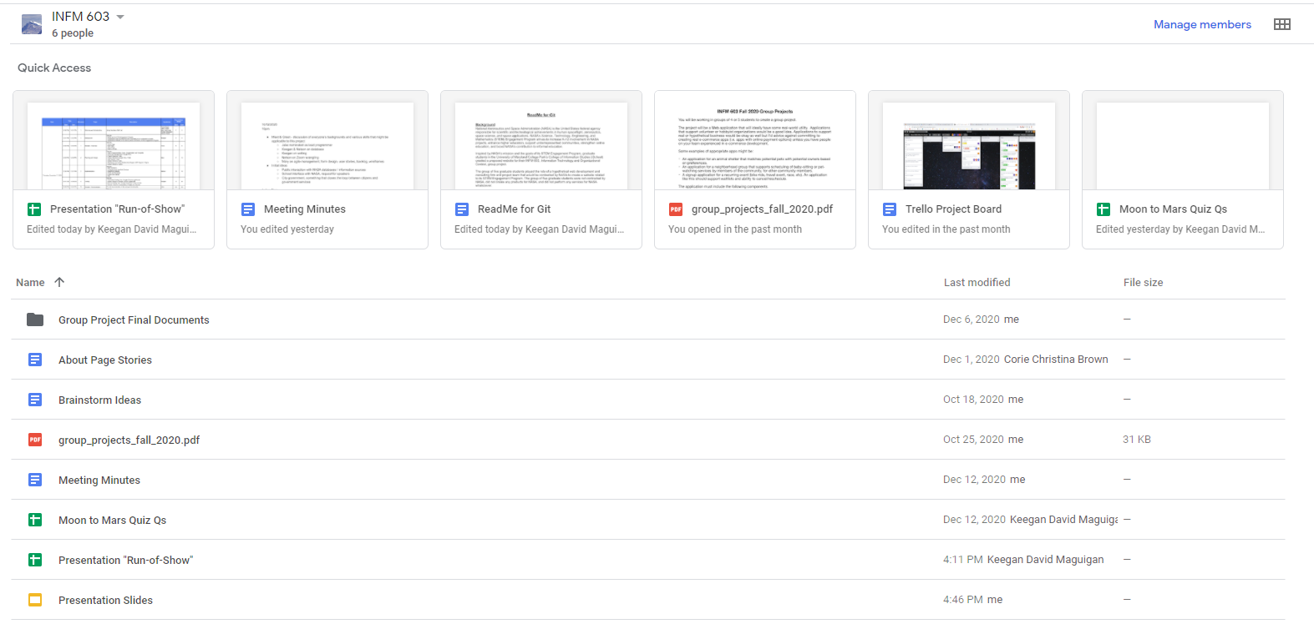
Google Drive

Slide 8
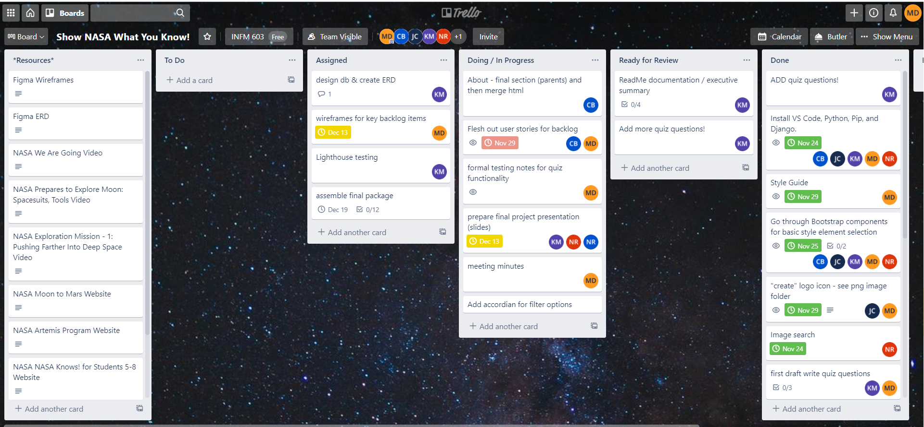
Trello for Project Management

Slide 9
Planning and Design
The group wrote users stories for students, teachers, parents, and others to identify and develop website requirements, and tracked the backlog, epics, user stories, sprints, and testing using Trello.

Slide 10
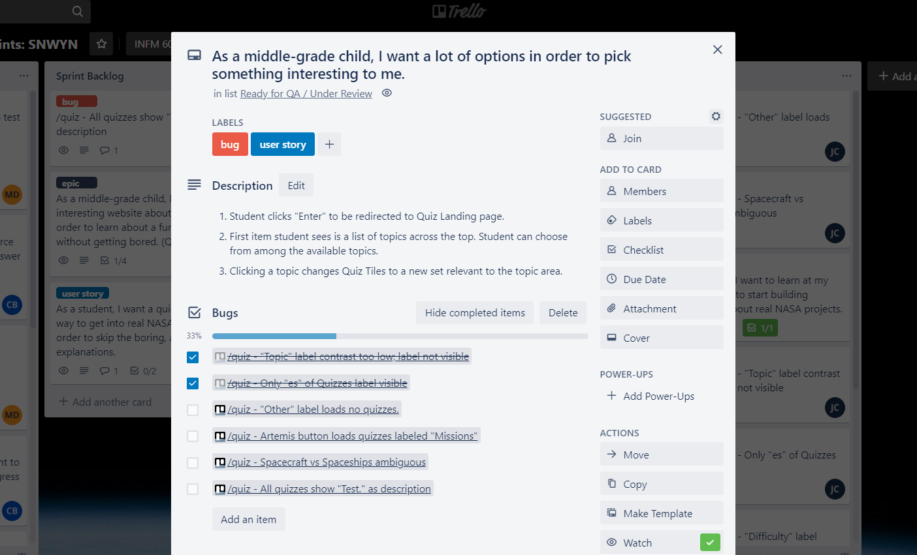
Trello for User Stories

Slide 11
Planning and Design
The group developed wireframes of the user interface for the main pages of the website using Figma. The group also developed wireframes for some of the major epics in the project’s backlog using Figma.
The group drafted an Entity-Relationship Diagram (ERD) to define the website’s conceptual data model for the database of quiz questions and answers. This ERD was created using Figma.

Slide 12
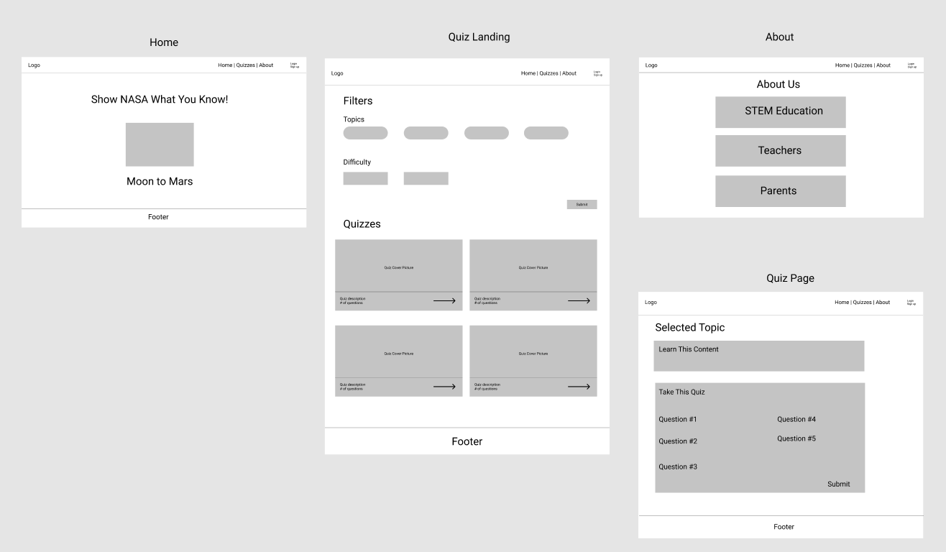
Figma for Wireframes

Slide 13
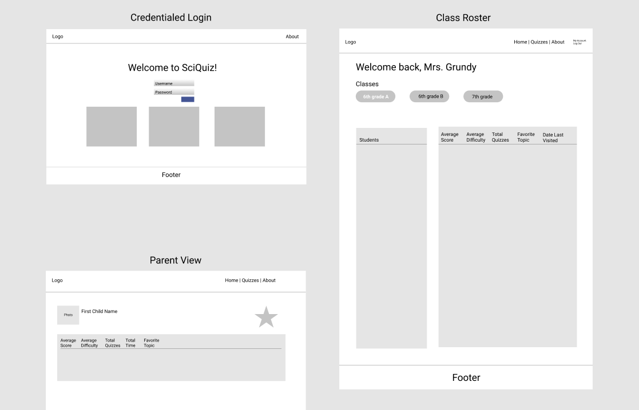
Figma for Backlog Wireframes

Slide 14
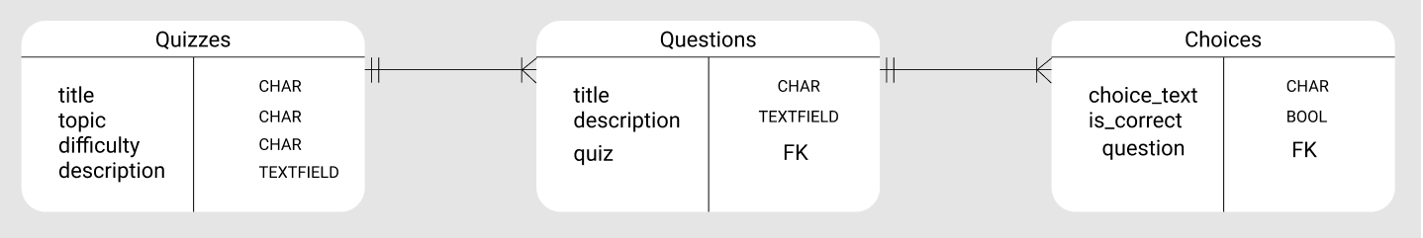
Figma for Entity Relationship Diagram

Slide 15
Implementation
The website was created to be web browser agnostic.
The website was also created for use on both desktop/laptop computers and hand-held devices and considers the resolution and interactivity of its display.
Lastly, the website was created for use on all operating systems.

Slide 16
Implementation
The group created the site using HTML code for site foundation and Bootstrap for site stylings and design.
The group created the Home, Quizzes, Quiz Results, and About pages using Python code in the Django web framework. The group used a SQL data store for quiz questions.
The group used Heroku for site deployment.

Slide 17
Testing
The group tested website functionality on the Chrome, Edge, Firefox, and Safari web browsers.

Slide 18
Testing (Continued)
The group used the Google Chrome Lighthouse audit tool to assess various performance, accessibility, best practices, and search engine optimization (SEO) factors by giving a score for each factor being assessed.
This tool assessed mobile and desktop usability and responsiveness for the Home, Quizzes, Quiz Results, and About Pages.

Slide 19
Testing (Continued)
The Google Chrome Lighthouse audit tool was also used to detect inefficiencies and mistakes as well as areas to improve our HTML code and other assets.
The project team also used the Google Chrome Developer Tools console to debug errors in the HTML code.

Slide 20
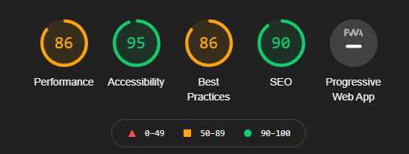
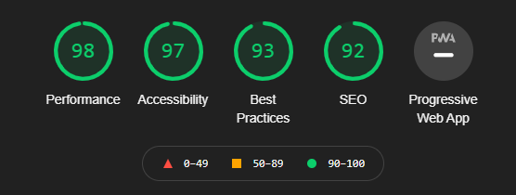
Google Chrome Lighthouse Testing Results
Desktop Audit Test
Mobile Audit Test

Slide 21
Testing (Continued)
The group also used manual tests to check the functionalities of the website and its underlying database based on the actions of website users.
The group tracked testing and bugs using Trello.

Slide 22
Testing Examples
Topic buttons loaded all appropriate quizzes and no others.
Difficulty buttons loaded all appropriate quizzes and no others.
Inappropriate use (“mashing”) of buttons did not break site functionality.

Slide 23
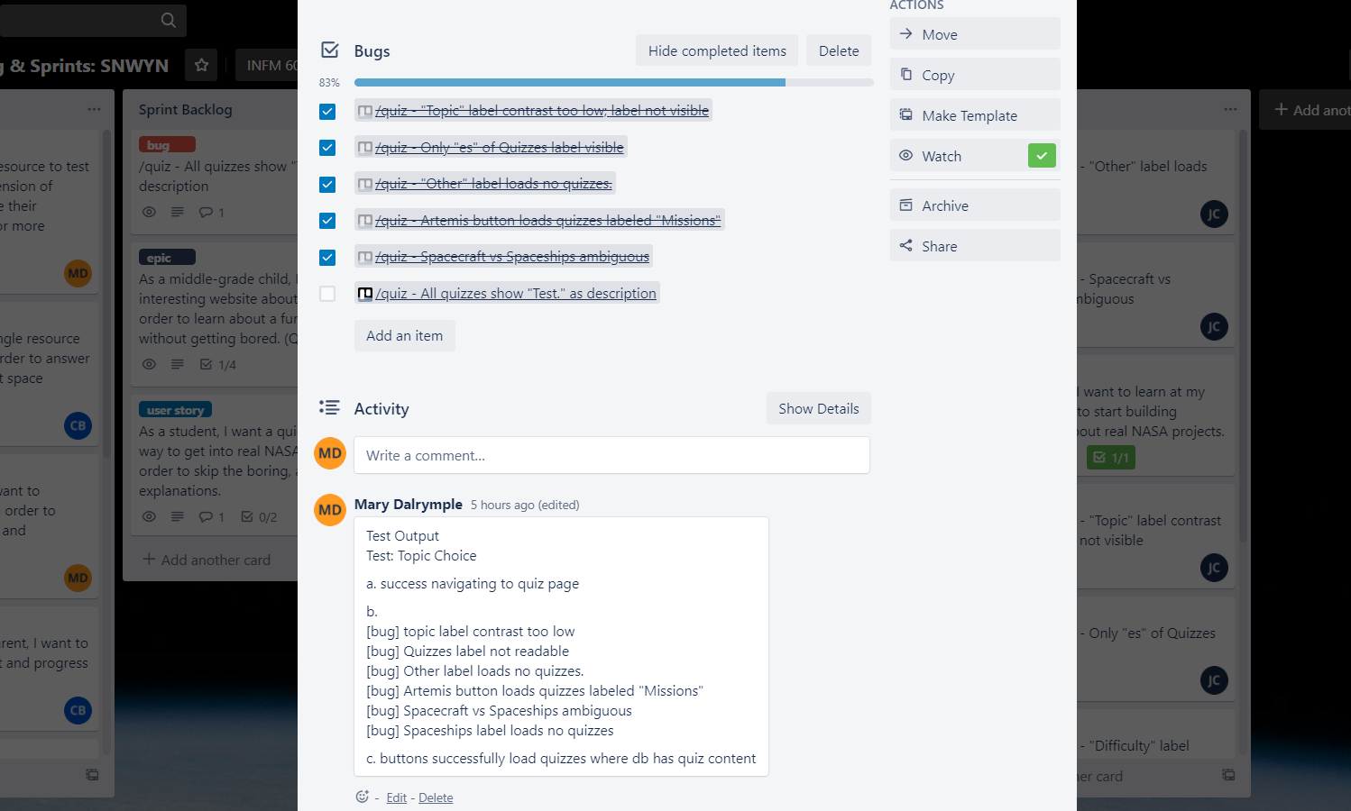
Trello for Testing and Bug Tracking

Slide 24
Website Demonstration
https://spacequiz603.herokuapp.com/

Slide 25
Backlog
The group established a backlog for items that can be added to future releases of the website to improve its content and functionality.
These items were documented in meeting minutes on the Google Drive, one of the Trello boards, as well as on our Figma site.

Slide 26
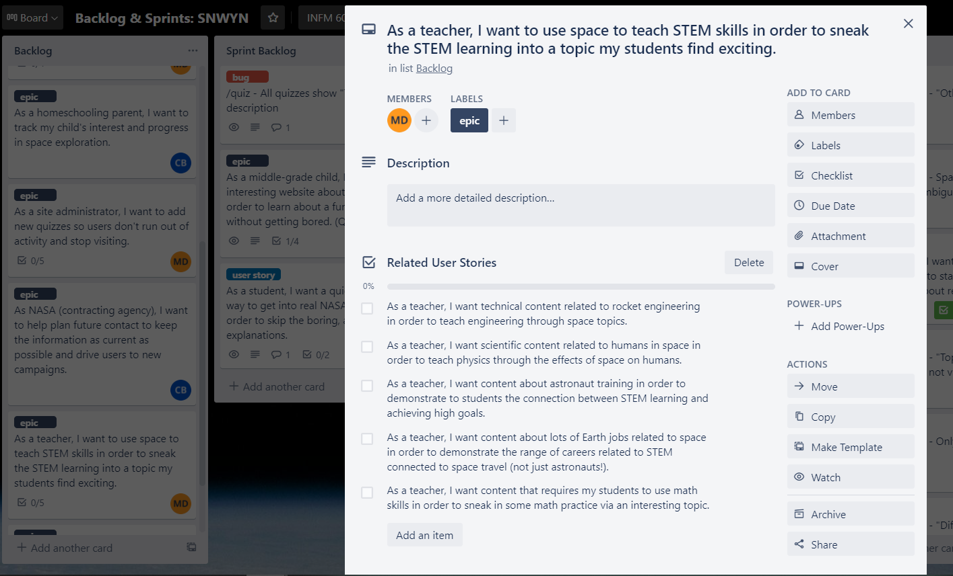
Trello for Backlog

Slide 27
Figma for Backlog Wireframes

Slide 28
Backlogged Items
Additional information, hyperlinks, videos, and/or pages that students can read and watch to learn more about a specific topic.
Pages where students can receive instructions for individual learning activities, such as observing and identifying the lunar cycle.
Site functionality that would randomize the selection of quiz questions for topics.

Slide 29
Backlogged Items (Continued)
Pages where students can type and submit short-answer responses to questions related to individual learning activities.
A page where students can type and submit questions to their teacher.

Slide 30
Backlogged Items (Continued)
Site functionality to capture and send quiz scores via email to teachers and/or parents for their review.
A credential and portal system for students, teachers, parents, and others that would allow them to view quiz scores and other class information.

Slide 31
Challenge and Lesson Learned #1
The group was unable to discuss and work with students, teachers, parents, and those with subject matter expertise in NASA and STEM topics to obtain their input and feedback on the site content and functionality.
As a result, the group learned the importance of stakeholder engagement in website development.

Slide 32
Challenge and Lesson Learned #1
To overcome this challenge, the group recommends creating an advisory board of users to obtain input and feedback on site content and functionality.
After working with this advisory board, the group would revisit and revise any user stories, requirements, site content and functionality for future releases.

Slide 33
Challenge and Lesson Learned #2
The project team considered its technical proficiency in web development applications as another challenge. While the project team was able to successfully implement, test, and deploy the website, it experienced difficulty learning how to use Bootstrap, Django, GitHub, and Heroku.
The project team acknowledged that these applications have steep learning curves which require additional and sustained use to master them.

Slide 34
Challenge and Lesson Learned #2
To overcome this challenge, the project team recommends engaging in future experiential learning opportunities to improve their proficiency in these applications.
By doing so, the project team members will be able to master these applications as well as develop practical solutions for complex problems.

Slide 35
References
The project team referred to and used subject matter, image, and technical resources for the website.
These resources were used to assist in the planning, design, implementation, and testing of the site.

Slide 36
References
The group referred to and used information from NASA websites, documents, videos, and images.
The group used images from World Vector Logo and Freepik.
The group referred to and used information from Bootstrap and w3schools for site stylings and design as well as Django for web development.

Slide 37
Question and Answer

Slide 38
Thank You!

